Slide 1

Movie Sales Analysis
Joyce Minoo

Slide 2

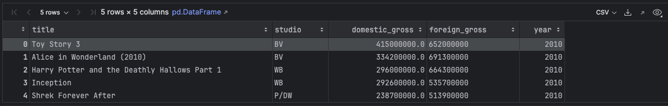
Data Overview
Representation of the data
Data brief description.
3387 movie titles entries
3382 studios entries
3359 domestic gross entries
2032 foreign gross entries
3387 year entries

Slide 3

Process in the Analysis phase
01
03
04
05
06
02
Business understanding
Data understanding
Data cleaning
EDA
Visualizations
Recommendations

Slide 4

Insights

Slide 5
Yearly movies sold
2015 had the highest number number of uniques movies sold followed by 2016
2018 recorded the lowest number of movies sold

Slide 6


Avengers was most sold movie
Avengers from BV studio recorded total gross of 1518900000 which was the most all time sold movie over the years

Slide 7

Top 5 Most sold movies → Total Gross
Movie Name | Studio | Total Gross
Marvel's The Avengers | BV | 1.518900e+09
Avengers: Age of Ultron | BV | 1.405400e+09
Black Panther | BV | 1.347000e+09
Harry Potter and the Deathly Hallows Part 2 | WB | 1.341500e+09
Star Wars: The Last Jedi | BV | 1.332600e+09

Slide 8
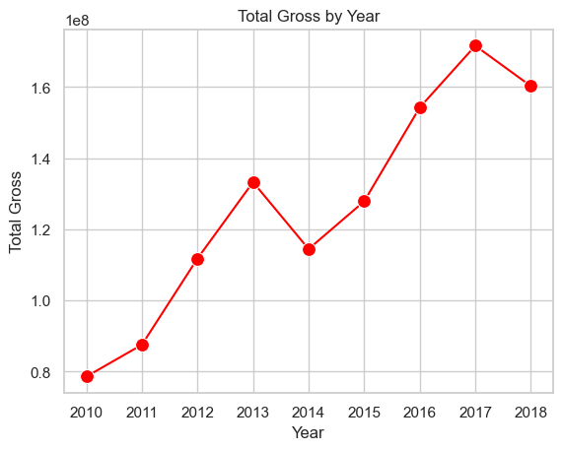
Movies Sales over the Years
Movie business has been lucrative over the years, with increasing gross revenues with slight dip in 2014 and 2018

Slide 9

Recommendations
Best Movies to upsell
Best Studios to work with
Worst Movies
“Marvel's The Avengers” had the highest Gross sales, it is the movie to go for
In terms of top sales, “BV” is the choice for movies business as its likely to get foreign and domestic viewership.
Most recent movies without foreign gross sales, especially the ones from Grav and specifically “An Actor Prepares” performed the worst ,so it isn’t a good idear to stocck it
Business
Focusing on movies with foreign gross has value, and movies a bit old in the market

Slide 10
The End

